Slide 1
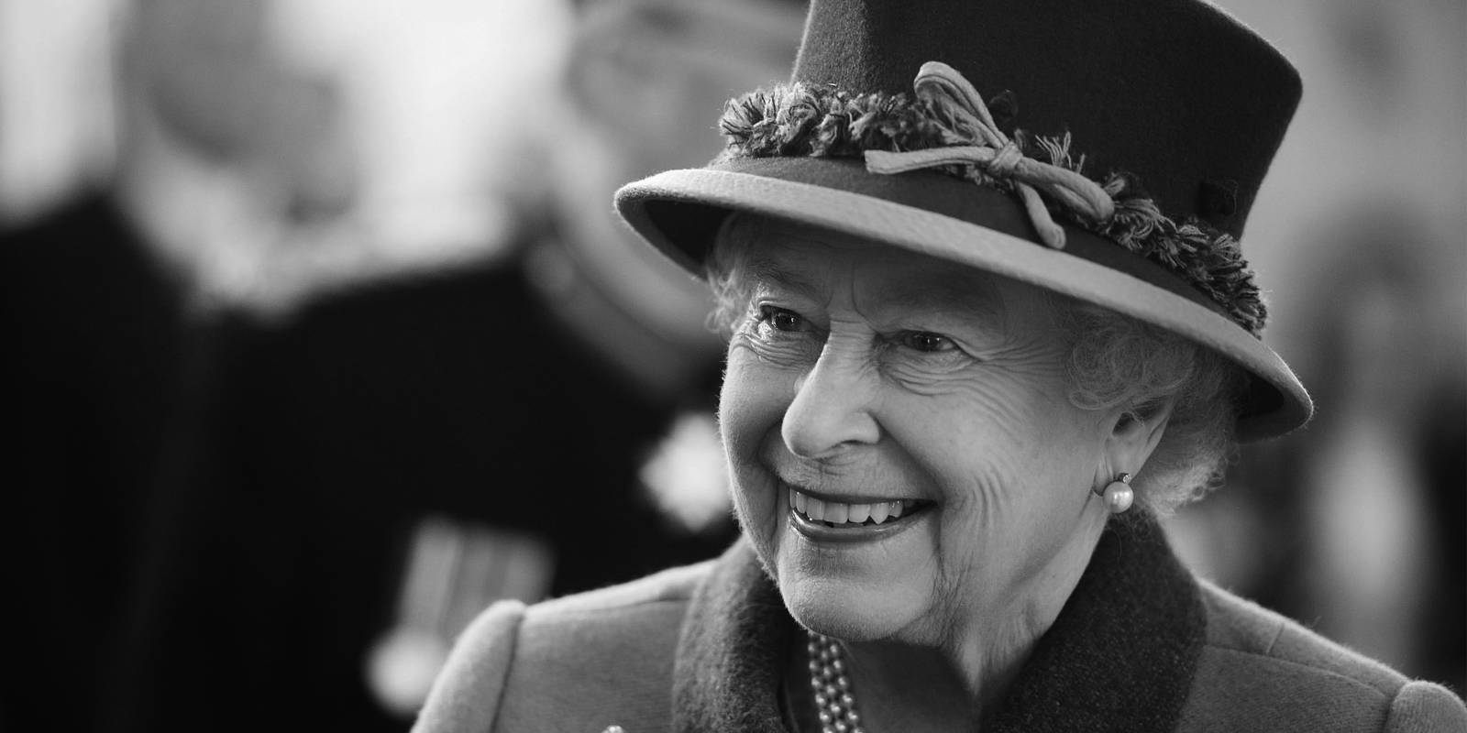

Slide 2
Gracious God, we give thanks
For the life of your servant Queen Elizabeth,
For her faith and her dedication to duty.
Bless our nation as we mourn her death
And may her example continue to inspire us;
Through Jesus Christ our Lord.
Amen

Slide 3
Vision 22/23
Confident disciples
Discipling our children and youth
All the gifts
Confident in Mission

Slide 4
Confident Disciples

Slide 6
